Slide 1
Project Xplore
Sub-topic

Slide 2
Index
Introduction
Bill Of Materials
Features and Specifications
Design Process
System Block diagram
Finite State Machine
Instructions
Test Plan
Development Timeline

Slide 3
Introduction
Problem statement: In the development of robots we find that the most efficient are the ones that can most flexibly move and sense the environment around them. One method of movement that would be worth exploring is that of omnidirectional vehicles. That is what will be implemented in Pac-bot. It would also gradually create a map of the environment by exploring and measuring the distance between itself and another object.
Implemented Solution: This will be implemented using a Stm nucleo microcontroller which will drive 4 motors each attached to mecanum wheels. It will use an ultrasonic sensor to measure the distance of an object in front of it and a matrix keypad to take in user input. It will also have an 16x2 lcd screen to output any necessary user information.

Slide 4
Bill Of Materials
Ultrasonic sensor module
16x2 Liquid Crystal Display Array
4x4 Matrix keypad
Breadboard
x4 DC motors
Mecanum wheels
Chassis
H-bridge driver

Slide 5
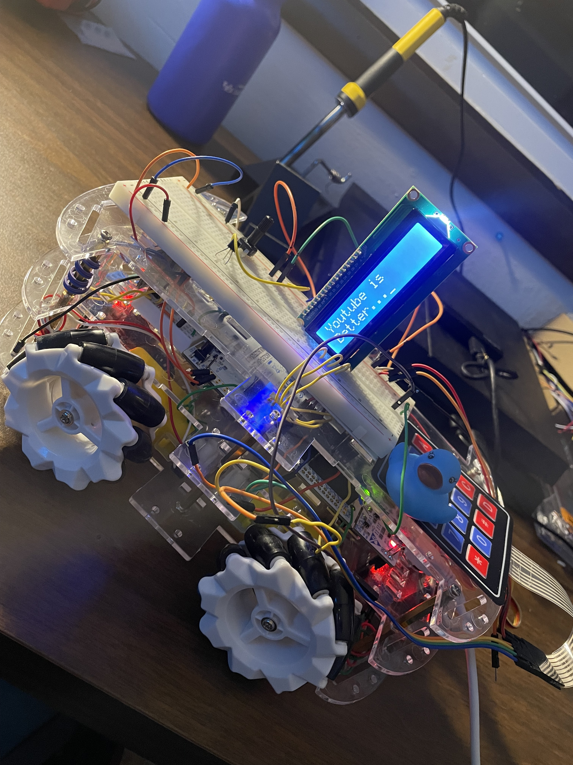
Features and Specifications
Omni-directional movement with mecanum wheels
Real-time distance acquisition
16 buttons for input commands
Breadboard space for extended debugging and functional capabilities
LCD screen for limited user interface

Slide 6
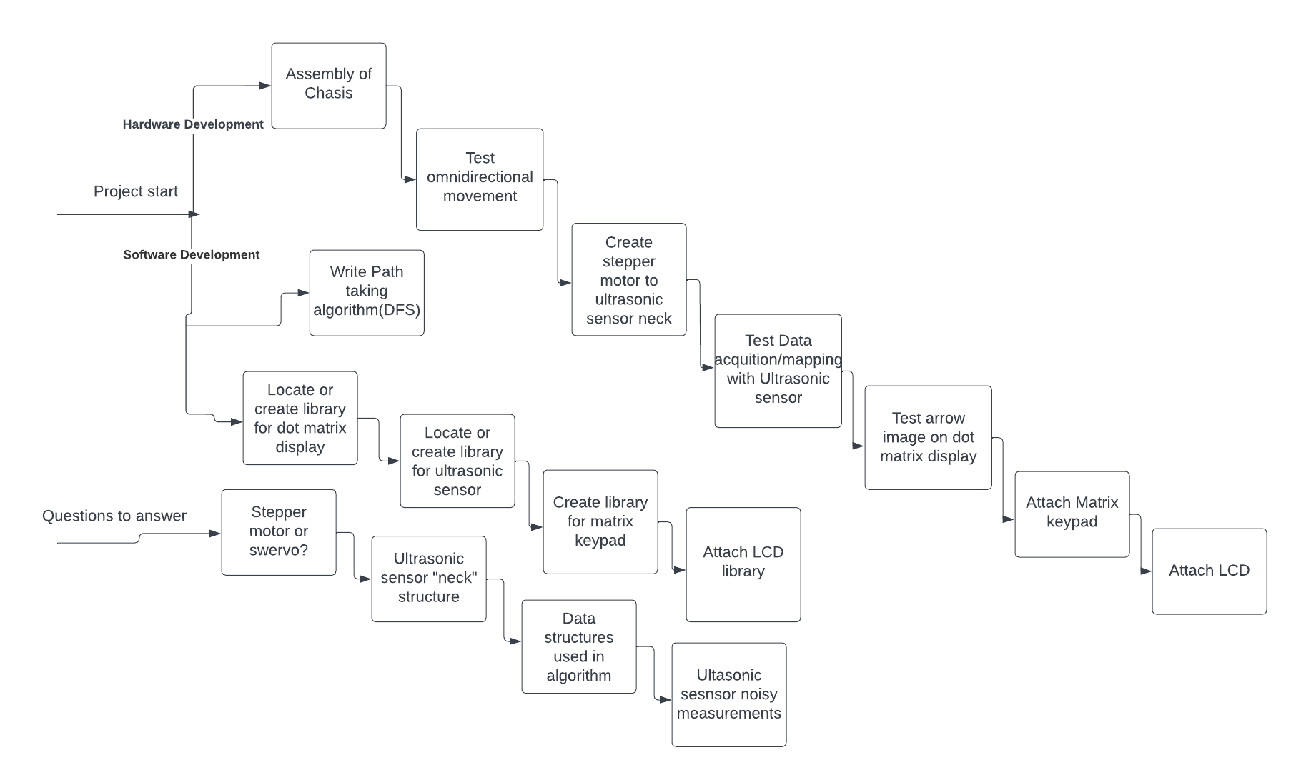
Design Process

Slide 7
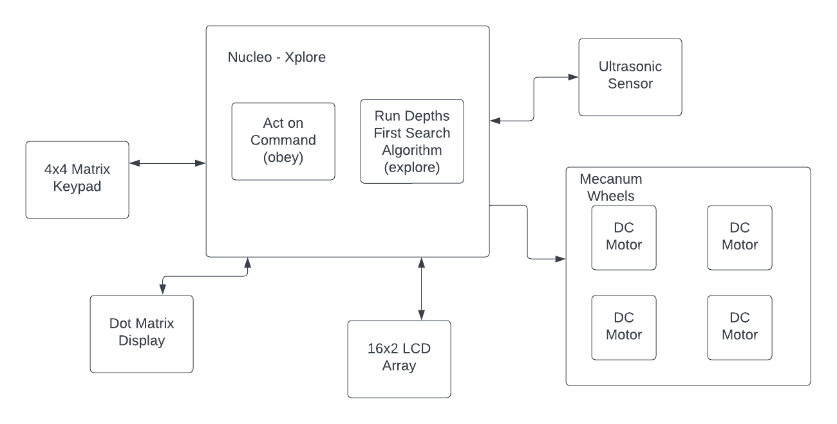
System Block Diagram

Slide 8
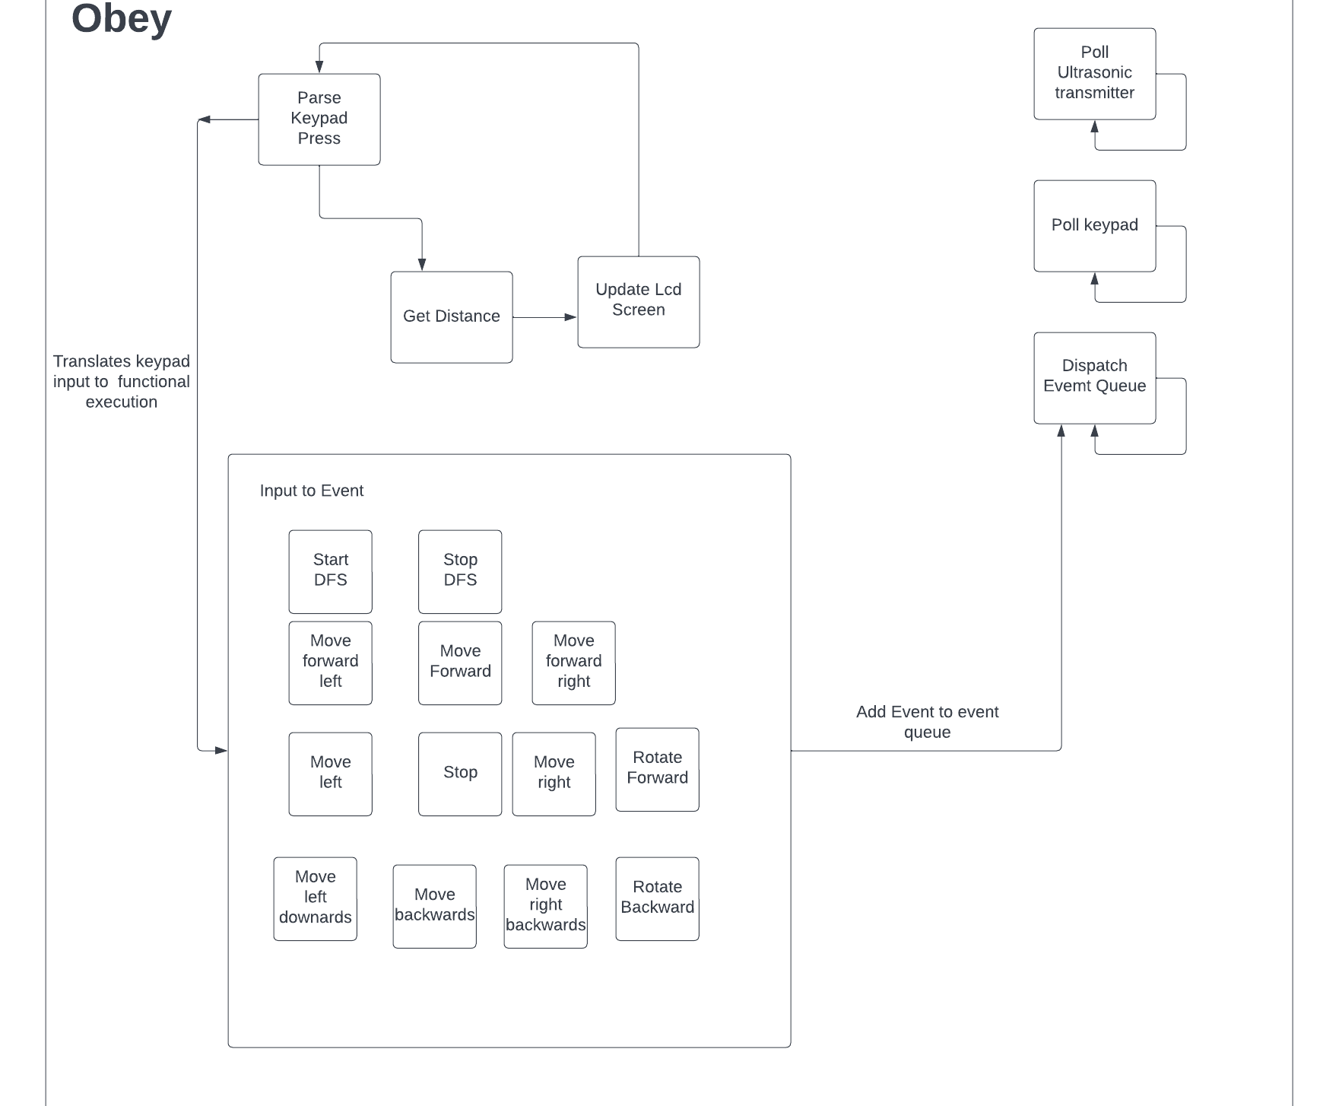
Finite State Machine
Currently the only mode that was implemented for the sake of this project was obey.
First it handles any previous button press on the matrix keypad which will also dispatch the relevant event
Then it updates distance from nearest object directly in front
Finally it updates the lcd screen with most recent information

Slide 9
Instructions with Chassis
Instructions without Chassis
Assemble motors to first layer of chassis
Attach Nucleo to second layer of chassis
Attach H-bridge driver to first layer of chassis
Connect components to Nucleo i/o pins
Matrix keypad (GPIO)
LCD (i2c)
H-bridge driver
x4 DC mtotors (GPIO)
Ultrasonic sensor (i2c)
Assign connected pins inn software class instantiations
Compile and run code
Connect components to Nucleo i/o pins
Matrix keypad (GPIO)
LCD (i2c)
H-bridge driver
x4 DC mtotors (GPIO)
Ultrasonic sensor (i2c)
Assign connected pins inn software class instantiations
Compile and run code

Slide 10
Test Plan – Most likely Issues
Most bugs that may cause software exceptions or due to sensor have been optimized and thus there are few notable bugs in the final stage of the project. These are the few that exist:
Slow moving wheels
Connect all Vcc ports of device components to an external battery rather than Nucleo Vcc. This will provide more current then than Nucleo can supply, thus providing more current to the individual motors.

Slide 11
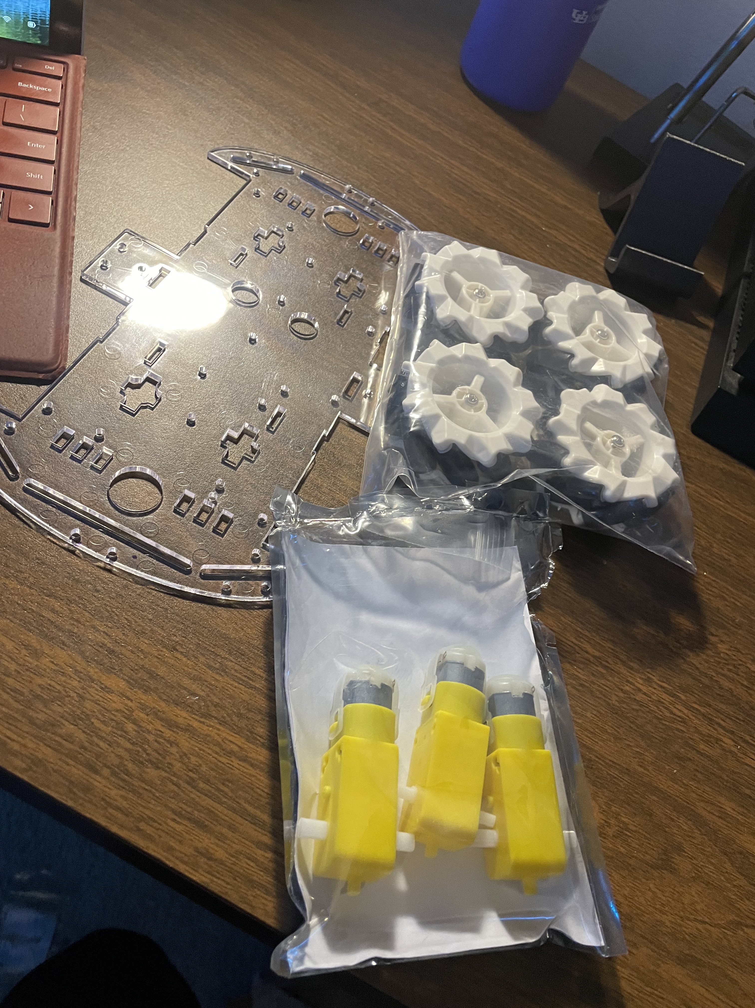
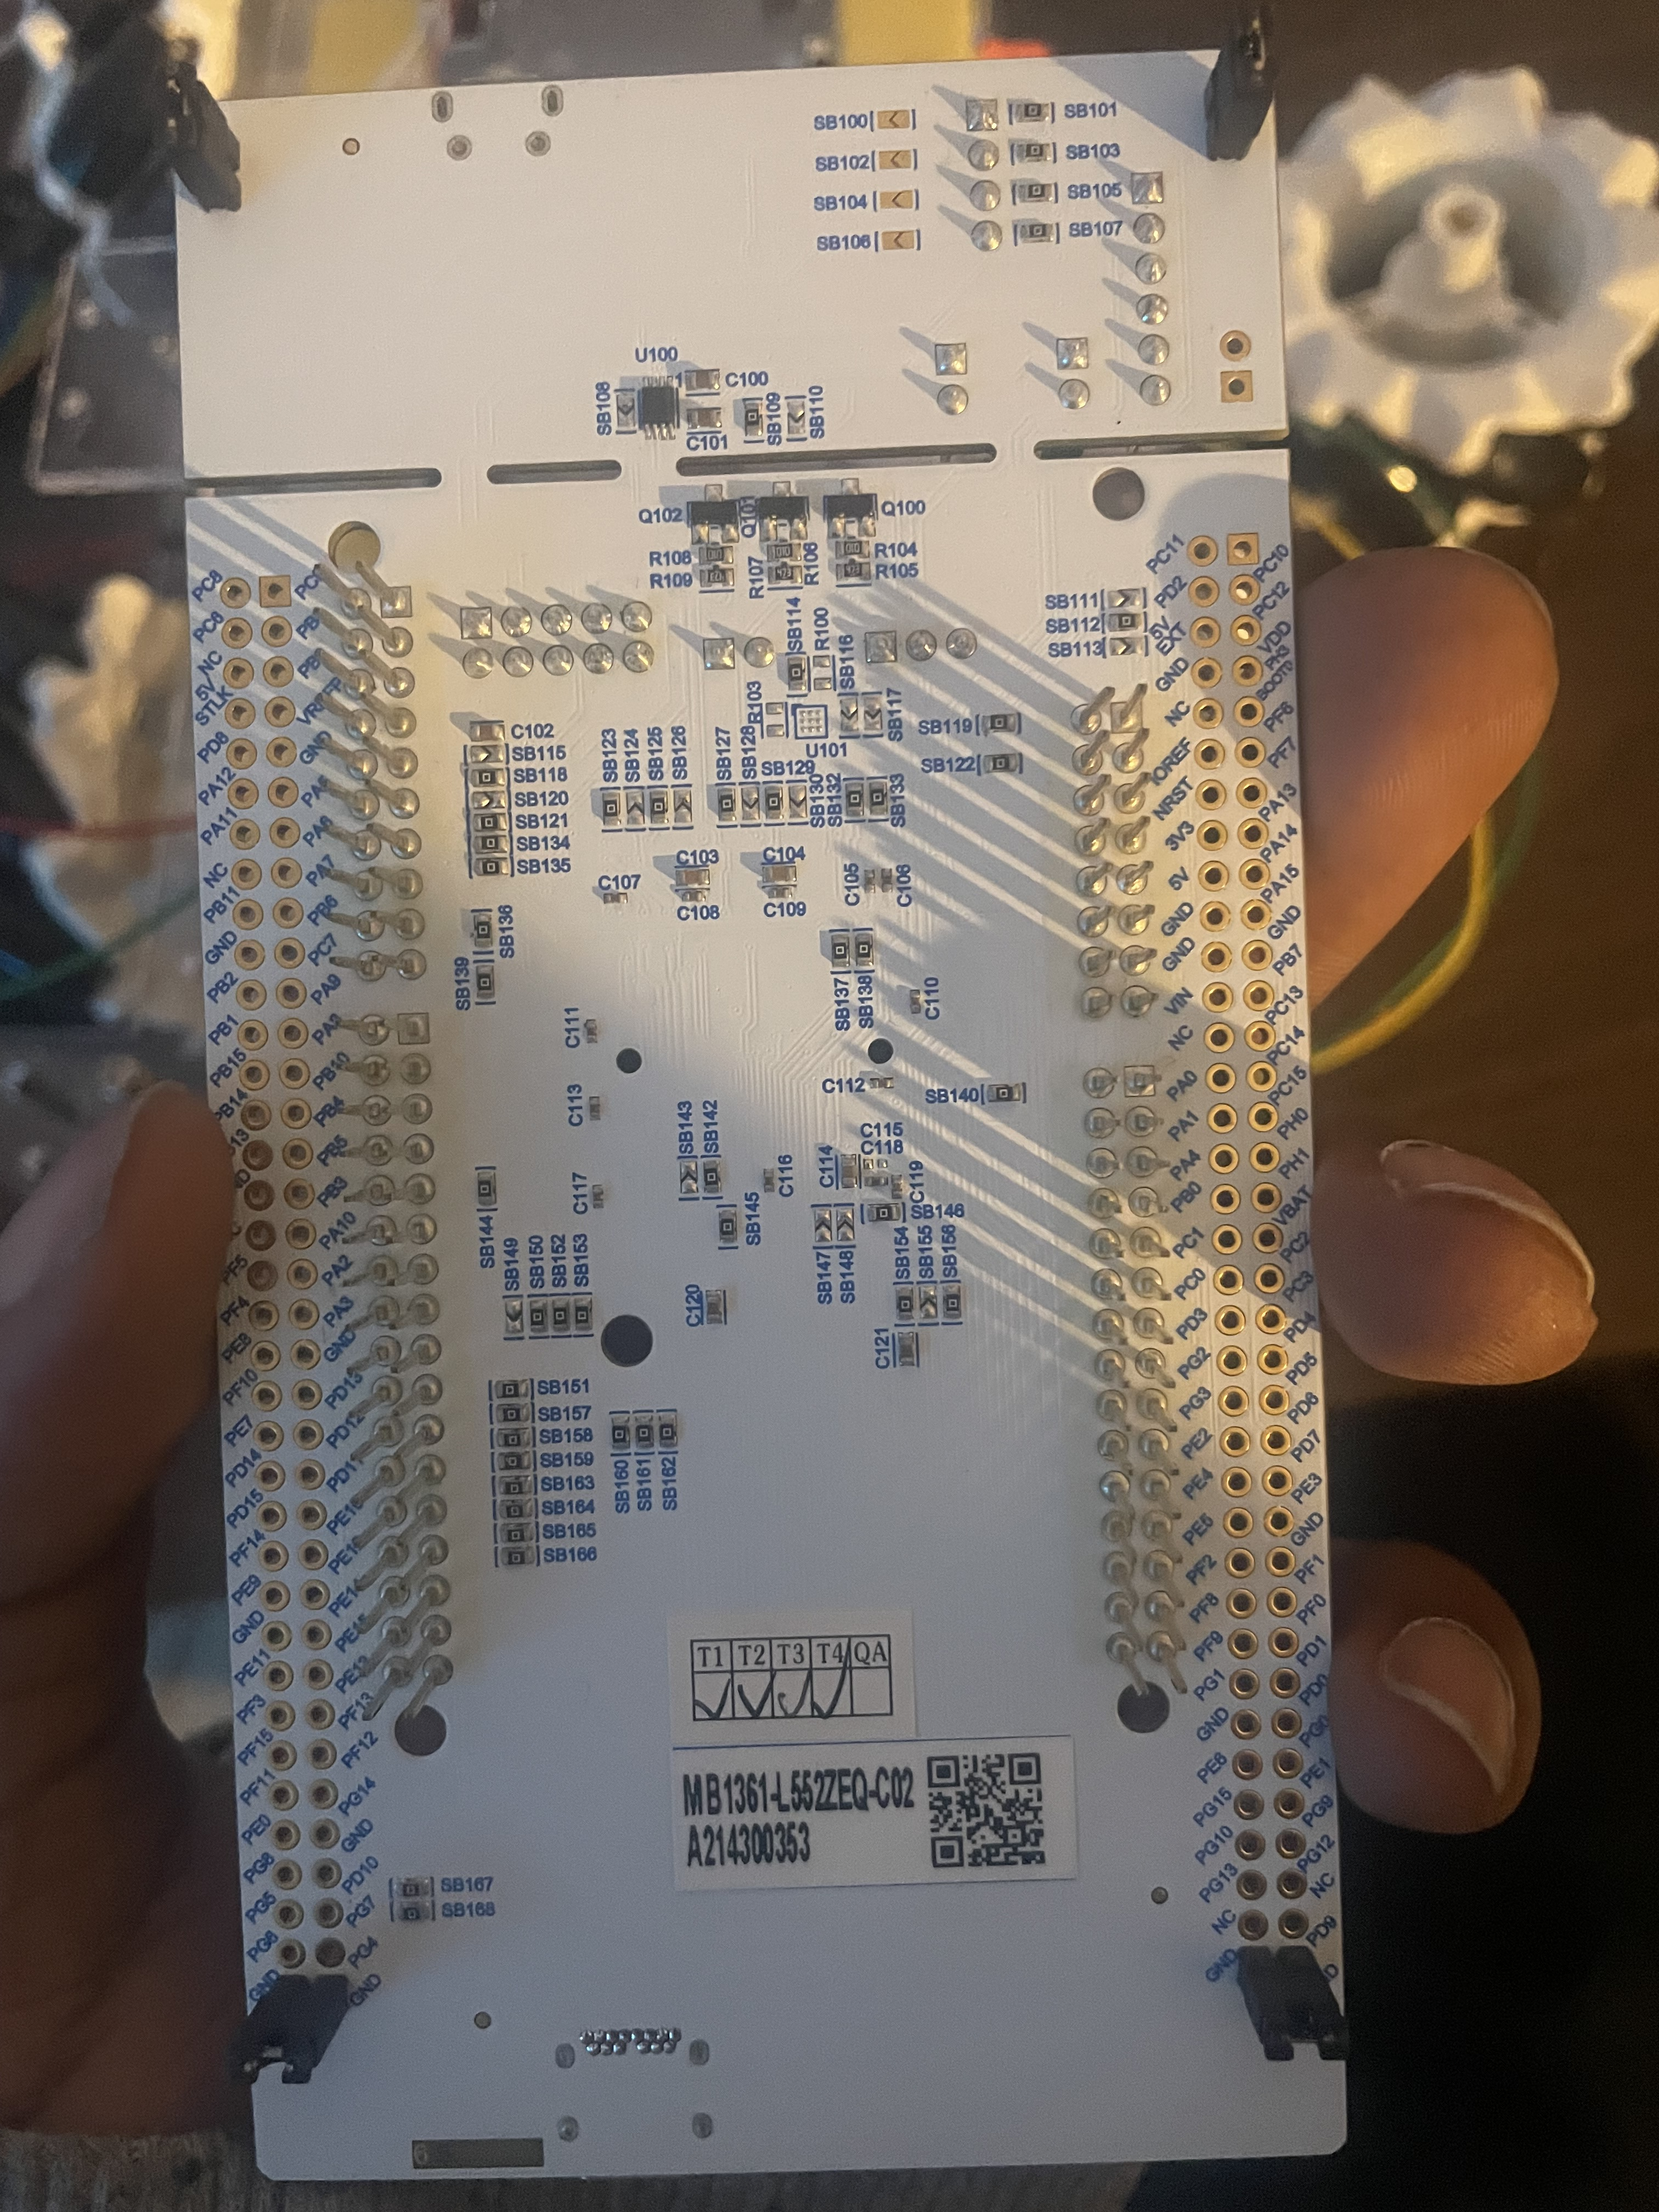
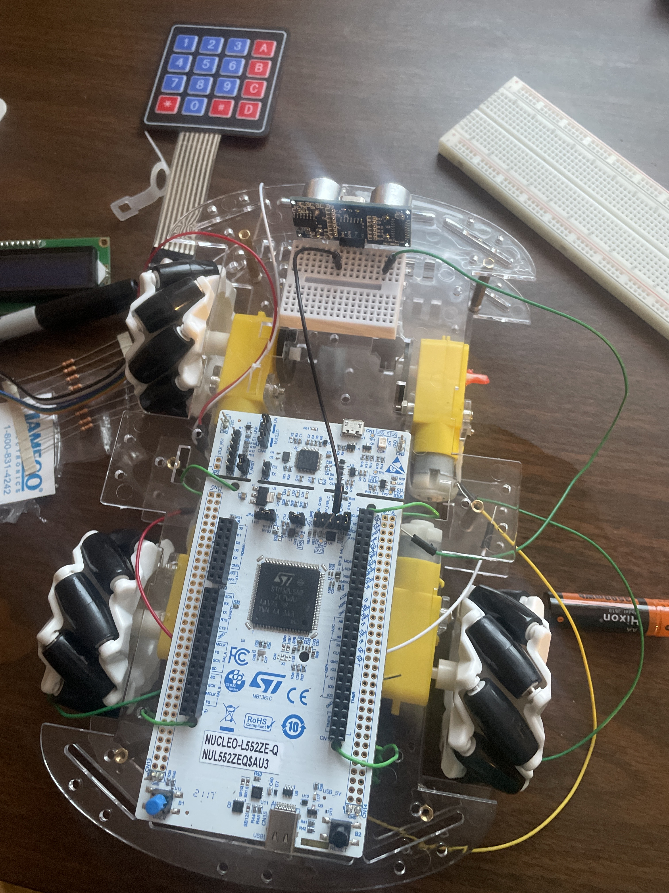
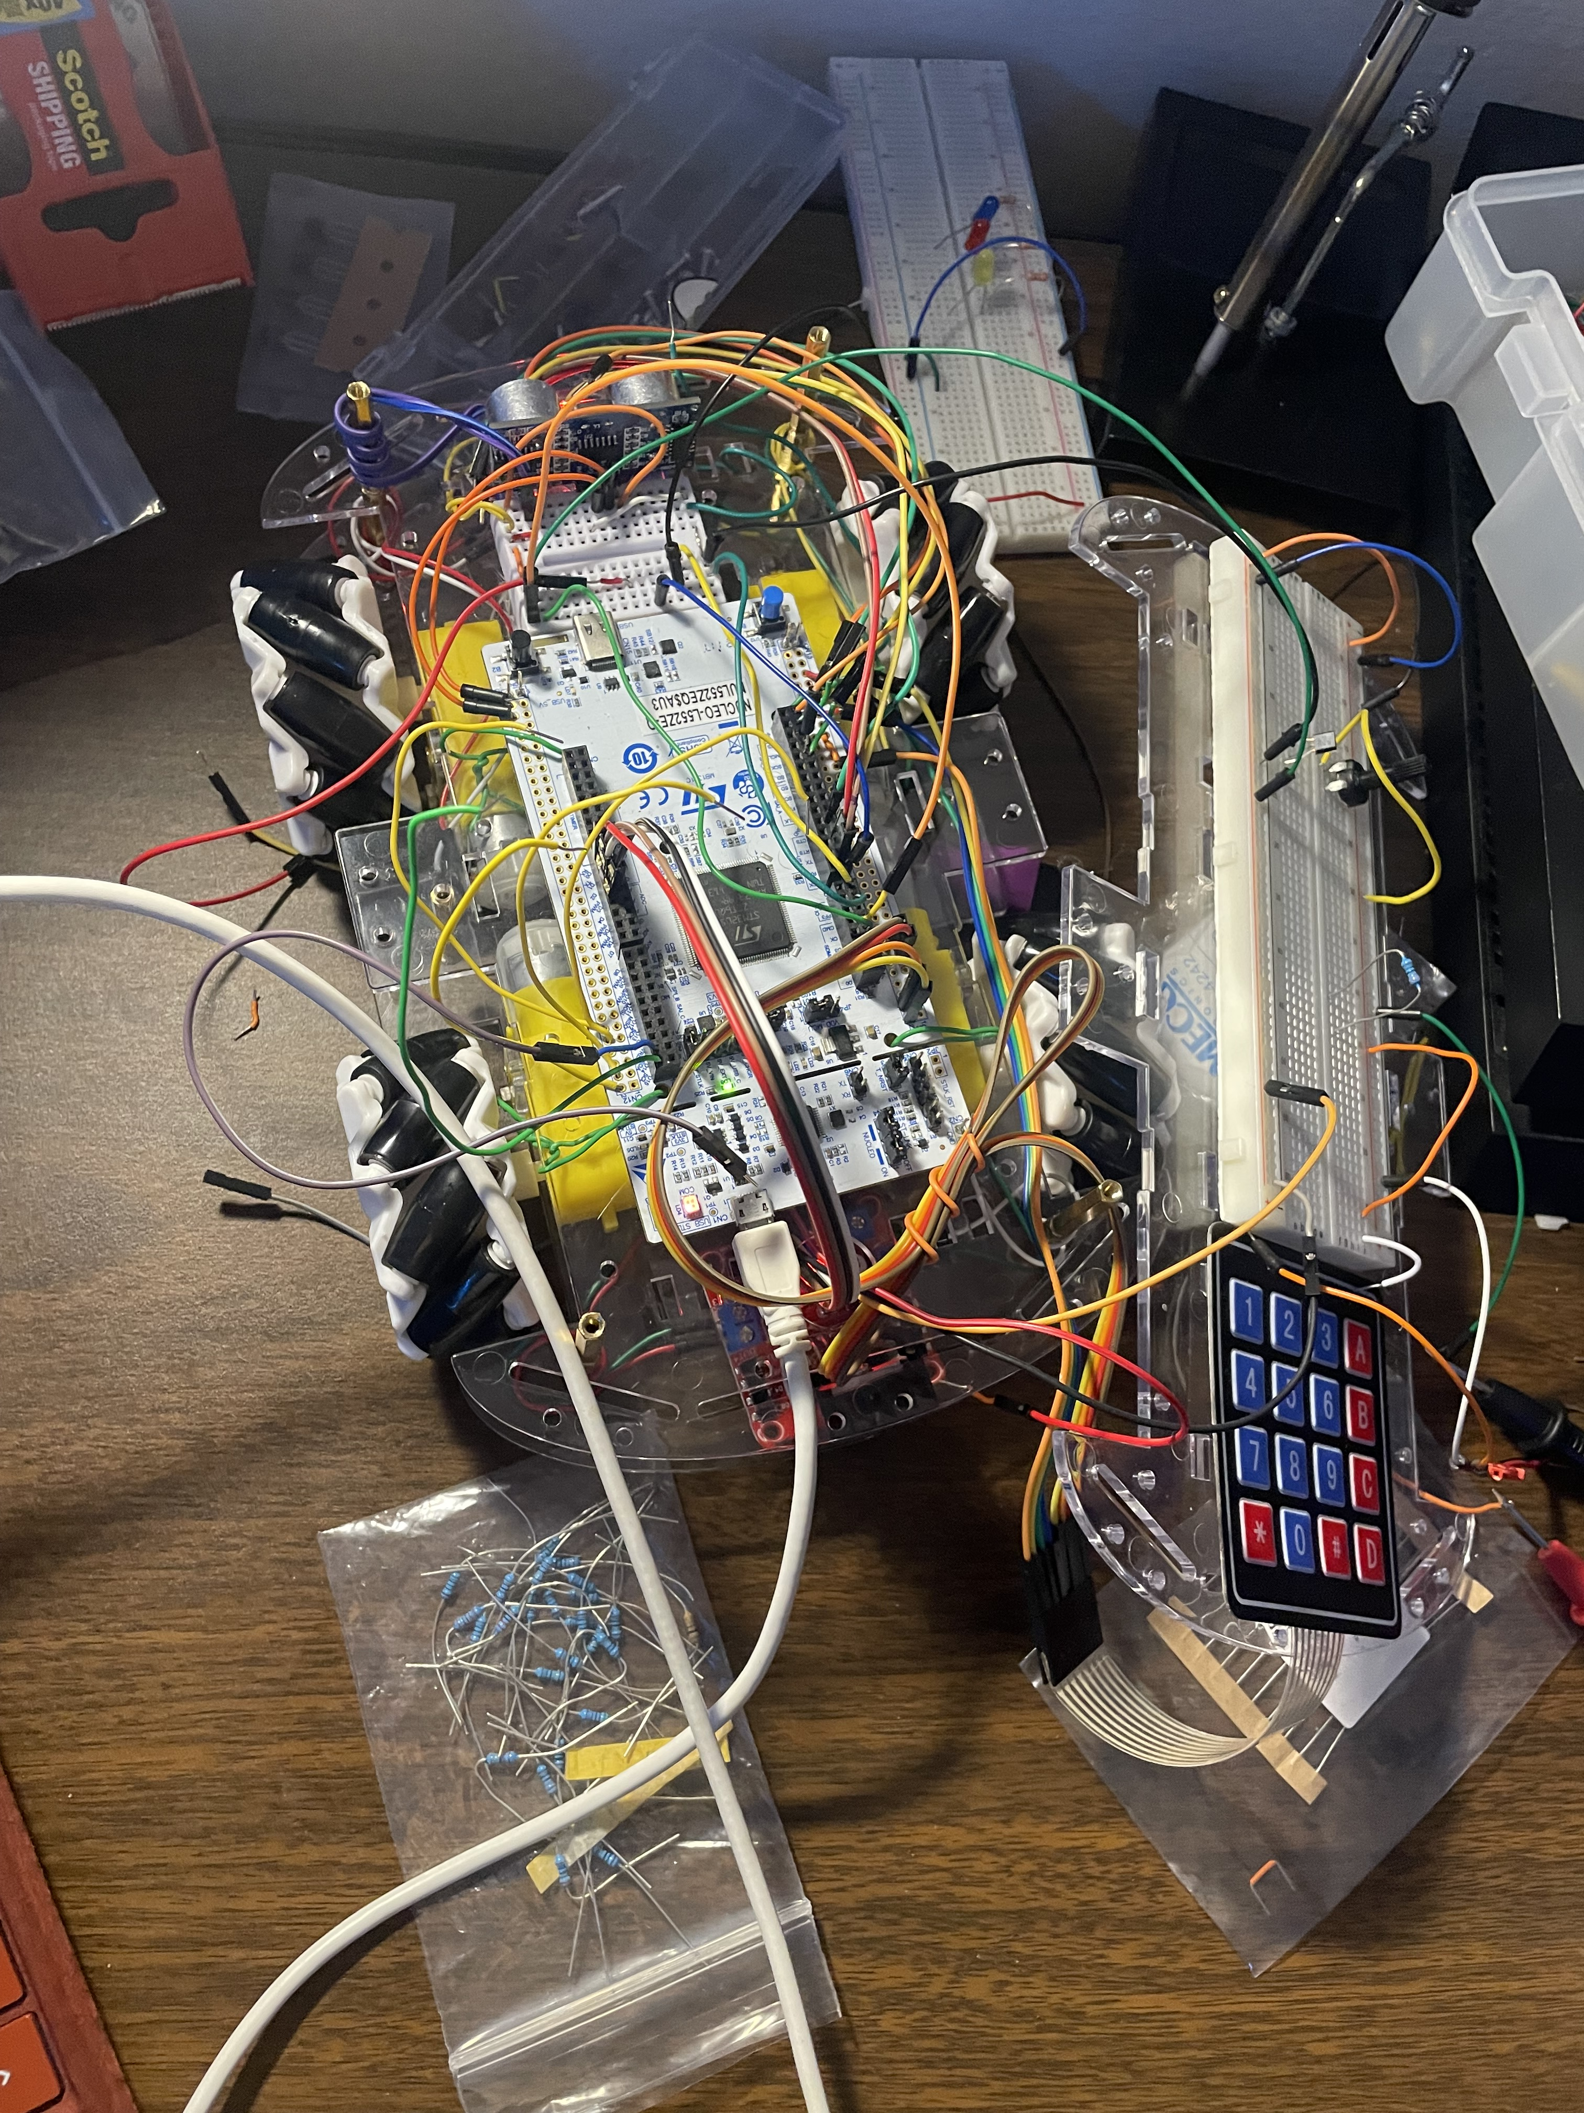
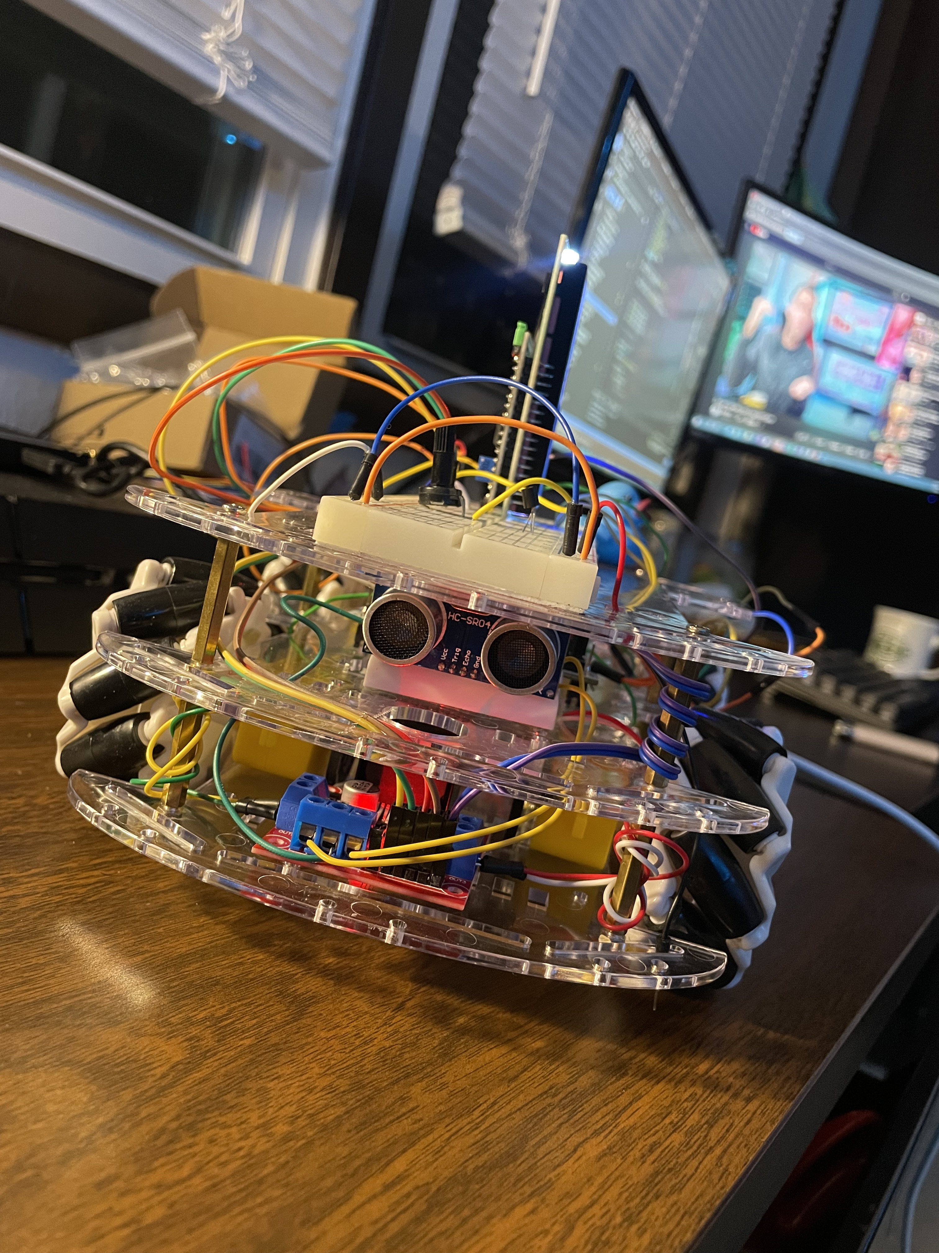
Development Timeline
Chassis assembly
Investigated individual sensor measurement mechanisms
Initialized GitHub repository for document storage
Captured pinout of Nucleo since it would have been out of view after assembly
Began designing object-oriented drivers for external components
Top-right wheel bearing broke during assembly… used 3d print filament to repair
Began designing object-oriented drivers for external components
Pre-full-integration
Successfully Debugged erratic sensor behaviors due to shorting wires
Successfully tested omnidirectional movement
Began integrating code
Fully integrated all components and code
Refactured code such that it was more oriented and capable of adding or removing features
Ran more movement tests based on keypad input

